Slide 1

Storytelling & Power BI
Creating reports that connect with different audiences

Slide 2
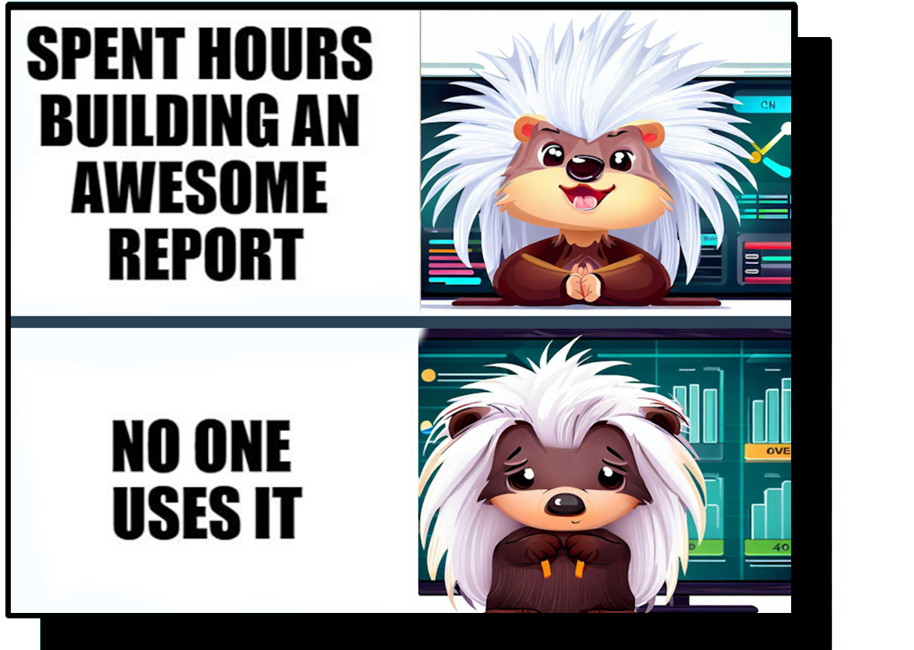
Dashboard
Delivery
Disappointment
Notes:
Dashboard Delivery Disappointment
Gathering, modelling, changes, designing
No one uses it
- Data is not correct (trust)
- Design is not user friendly
- User can’t find the answer they are looking for

Slide 3





Valerie Junk
PorcuBI - www.porcu.bi
The Netherlands
www.linkedin.com/in/valeriejunk/
porcubi
valeriejunk.bsky.social

Slide 4



Storytelling Benefits
Easy to follow and understand
Engaging
Time-saving
Notes:
There are three main benefits to using storytelling in Power BI:
Easy to follow and understand
Instead of searching for information, looking at information next steps
3. Time-saving: making quick and effective decisions.
-> Create reports that matter

Slide 5







3 steps to use Storytelling
Research
Create
Deliver
Notes:
How to start
3 steps
Research:
- just like with a normal story
- Audience and Content they are looking for
Create
- creating the narrative
- Storyboard, templates, visuals
Delivering
– even a report using storytelling still needs to be delived in a good way –
How to check it

Slide 6
Research
Audience, content & key message
Notes:
10
Selling a general story – never as good as a tailored report

Slide 7

The audience
Who is the audience?
What is the experience level?
What information do they need?
Actions to take.
Motivation / Scares.
Notes:
Who is the audience - prevent confusion
Who : Big group, one individual
Different approach, different needs -- scroll X example
What motivates them (steps to take)
- Example sales team – target hit and how to improve
- What actions do they want to take based on report
-How much detail
- Overview vs Detailed
Preferred communication – dark mode, phone

Slide 8
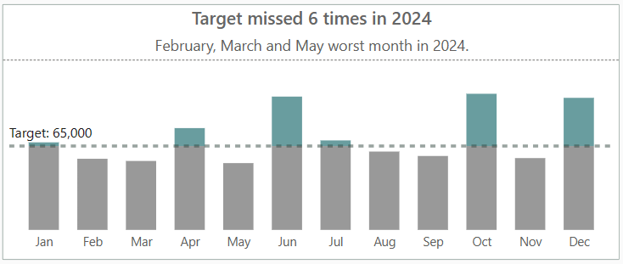
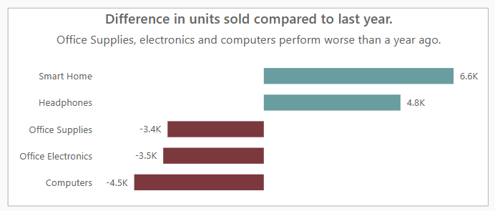
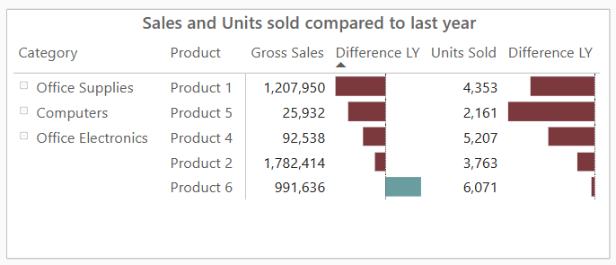
Why actions & motivation?
When you know the actions and processes, you can provide context and supporting information.
Adding meaning to the visuals.
Notes:
Who is the audience - prevent confusion
Who : Big group, one individual
Different approach, different needs -- scroll X example
What motivates them (steps to take)
- Example sales team – target hit and how to improve
- What actions do they want to take based on report
-How much detail
- Overview vs Detailed
Preferred communication – dark mode, phone

Slide 9



What’s the message?
1 key message (sentence)
Context
Information
Actions to take
Notes:
What information do the user need
Choose visuals, conditional formatting and data labels
1 Page = 1 key message
Context (example: a monthly sales report for the account managers)
Information (example: KPIs & measuring performance of account manager and products)
Actions to take with the result (Example: evaluate performance & strategy)

Slide 10
Not a key message
Context
Sales Insights
Information
All
Actions to take
TBD
Notes:
Context
Information – everyone , everything
No actions to be taken
Context – Sales insights, all of all years, everything we have, for everyone
Information – all, all dimensions
Actions to take
Recipe for disaster

Slide 11
3 examples
Each year we share information with the whole company what our key sales results are (profit, costs, margin, difference LY).
As MT we evaluate monthly the key sales results, the performance of our account managers (€ vs target) and the best/worst products.
Our data analysts daily dig through all the data to investigate hidden trends and anomaly's.
Notes:
Context
Information
Action
Yearly, information, whole company , KPIs
No filters or anything, could be an infographic
MT, monthly evaluate, key sales results and performance accountmanager and best wordt product.
Data analyst, trend anomalies, huge amount data, own analysis

Slide 12
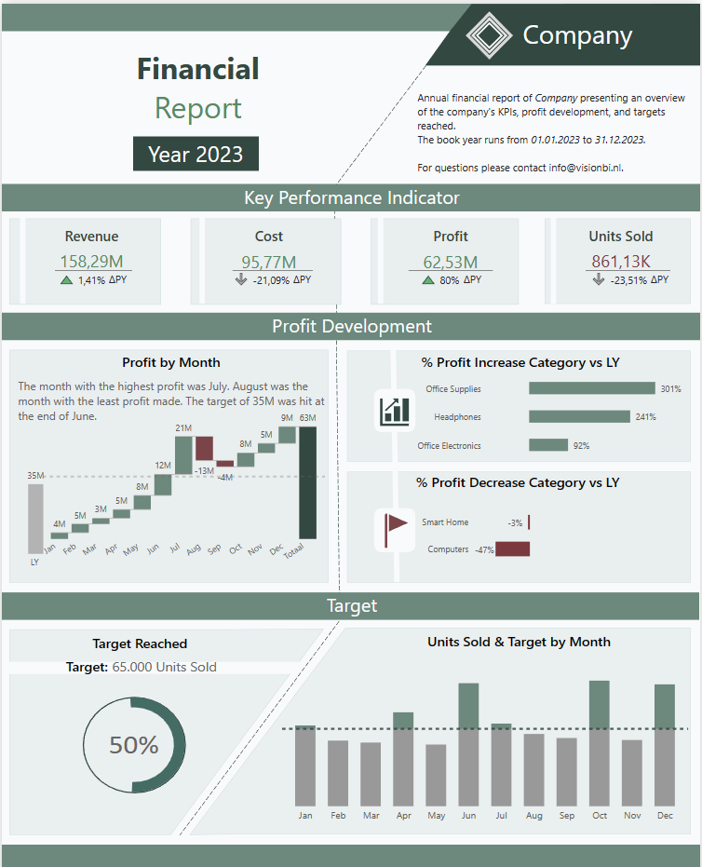
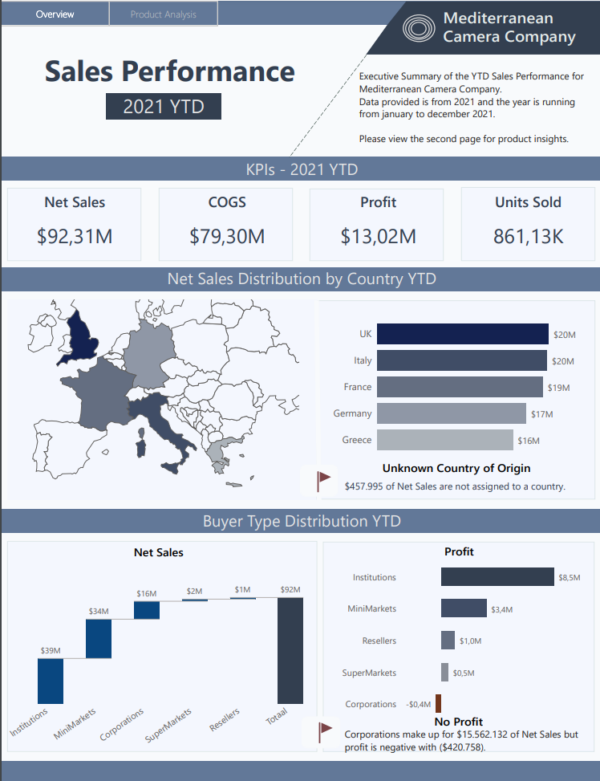
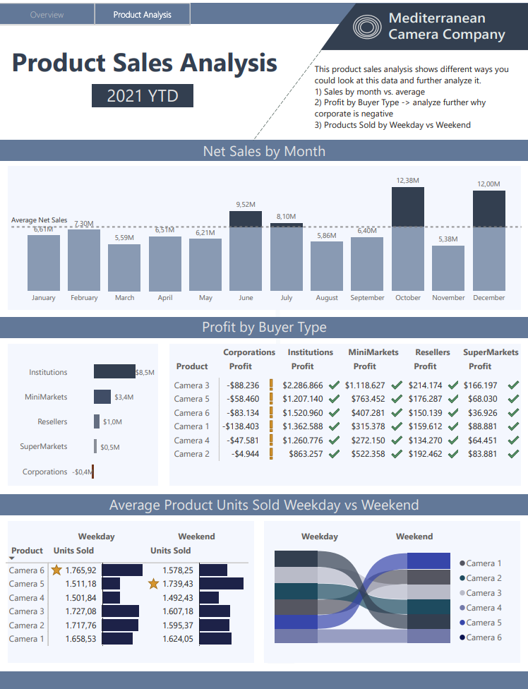
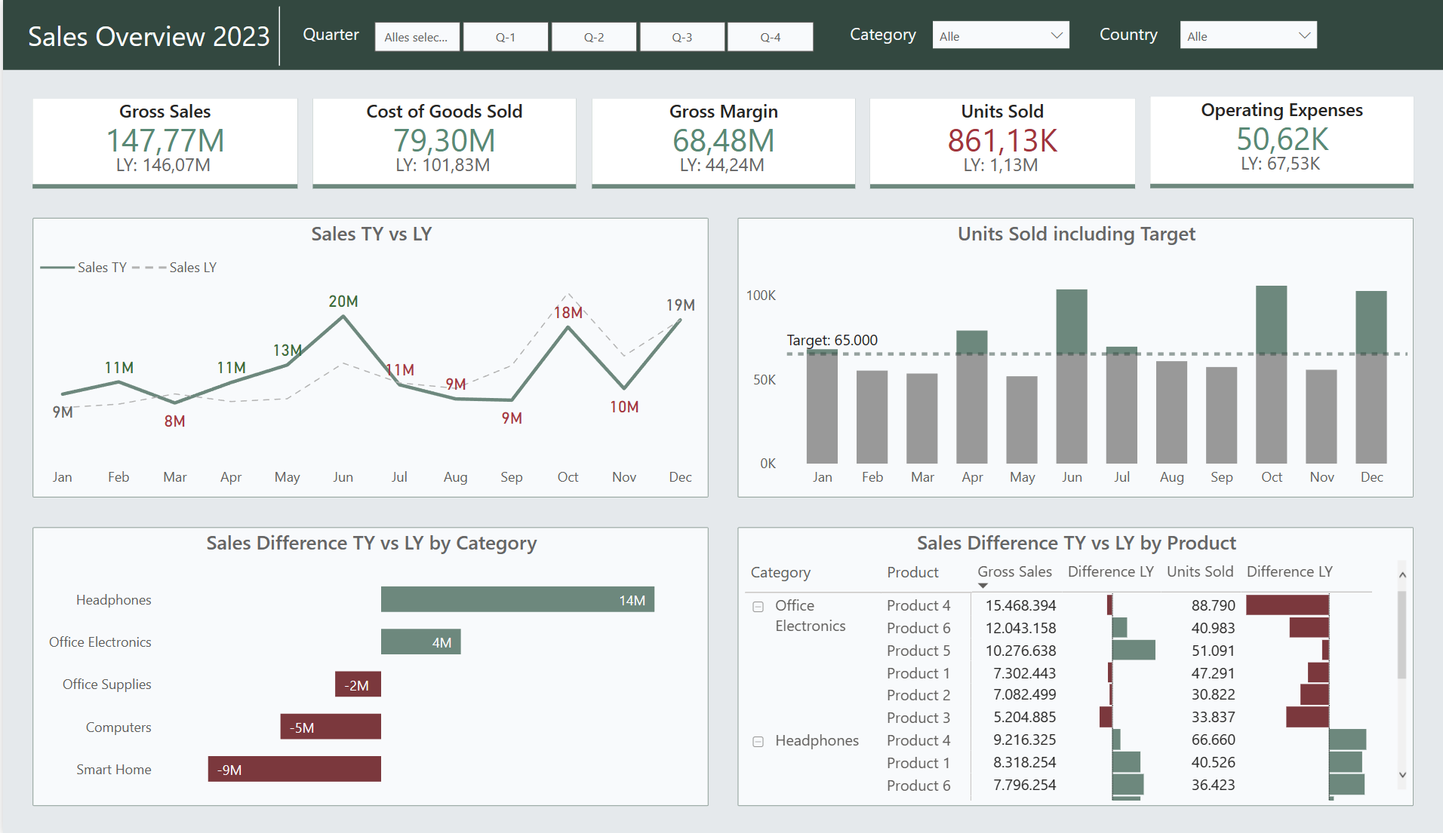
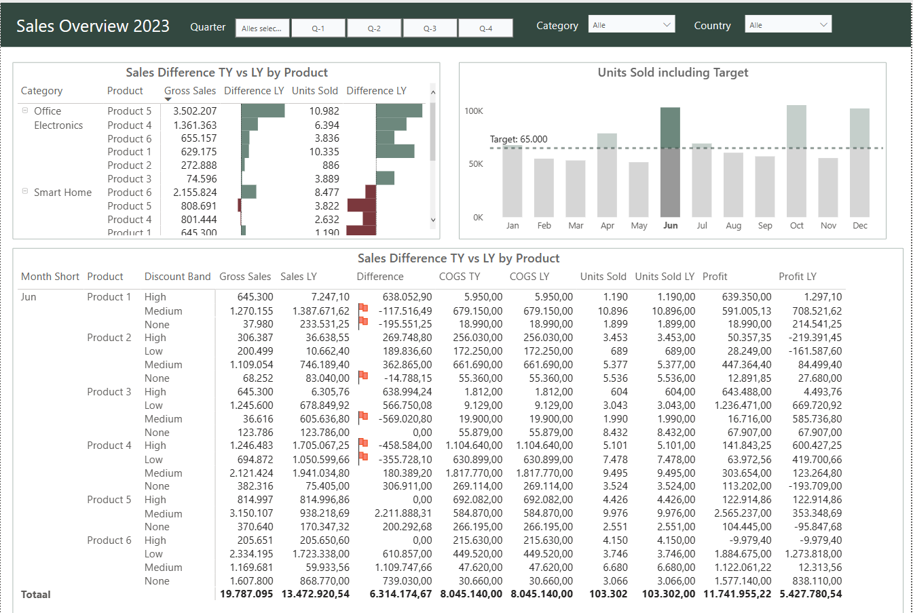
Different message = Different Design
Notes:
Lowest Details to most details
Could be combination

Slide 13
Create
Storyboard, Templates & Visuals
Notes:
30

Slide 14

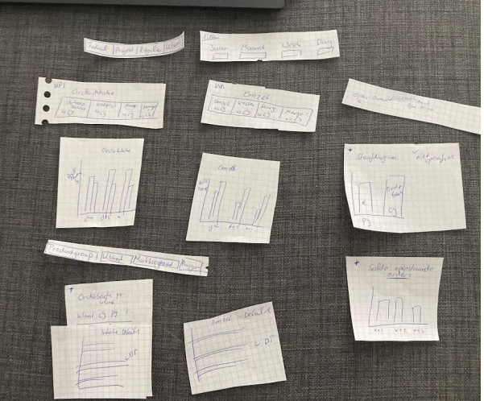
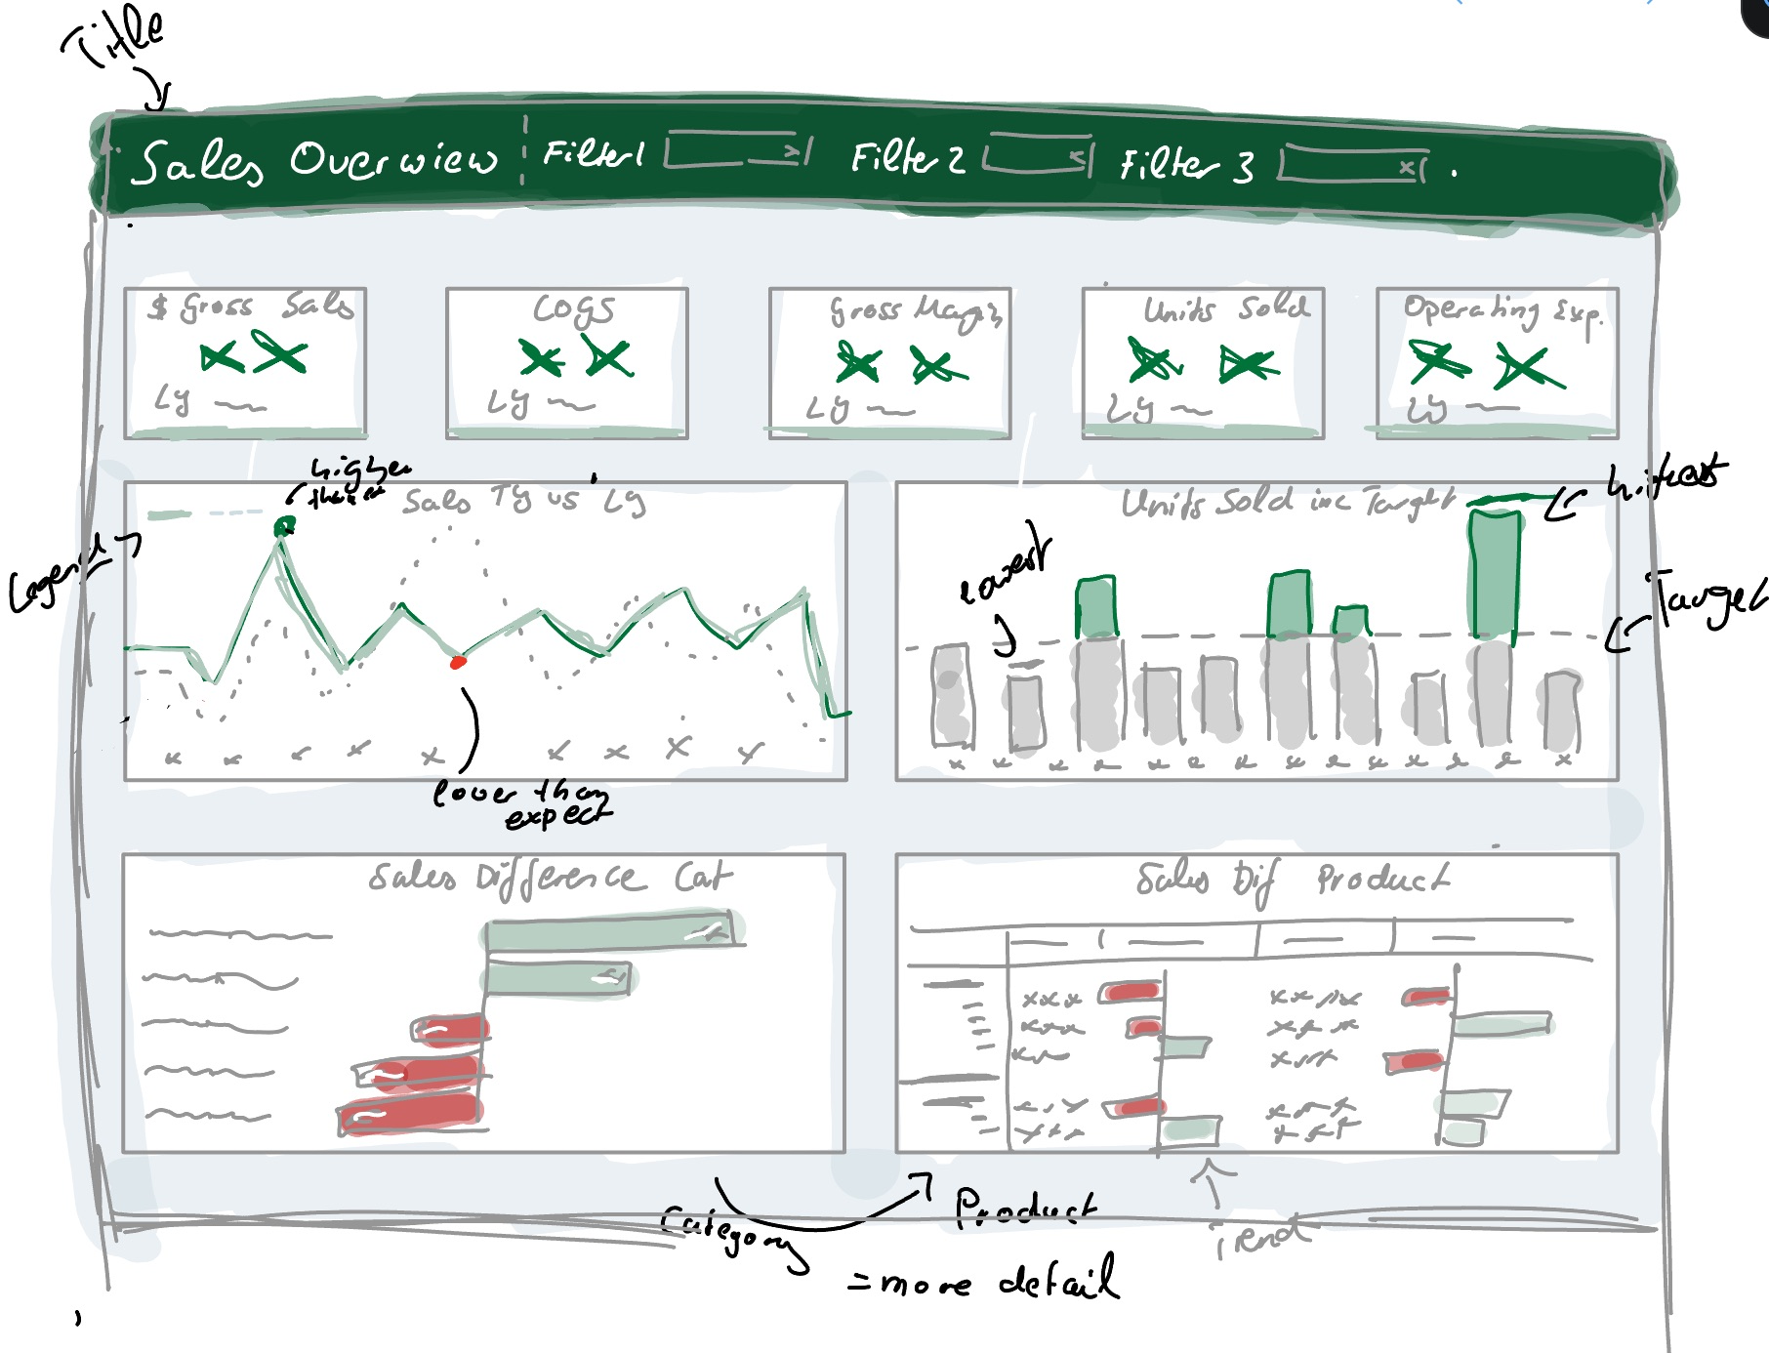
Storyboards & Mock-ups
Gather all the information
Sticky Notes (easy to rearrange)
Translate pieces to design
Each piece tells a part of the story
Check your story
Notes:
Visual representation of information
Translate each piece to a design
Keep it simple
Check your story
Pen paper – not power bi
Keep it simple – no side quests

Slide 15
Templates & Consistency
Improve the ease of usage
Focus on the data, not on handling the tool.
Templates
Color schemes (example: color.adobe.com)
Notes:
Consistency – do not spend time navigating, searching for buttons every time again
Example:
Filters
color scheme –
example product groups
functionality (drill through, filter selection)

Slide 16
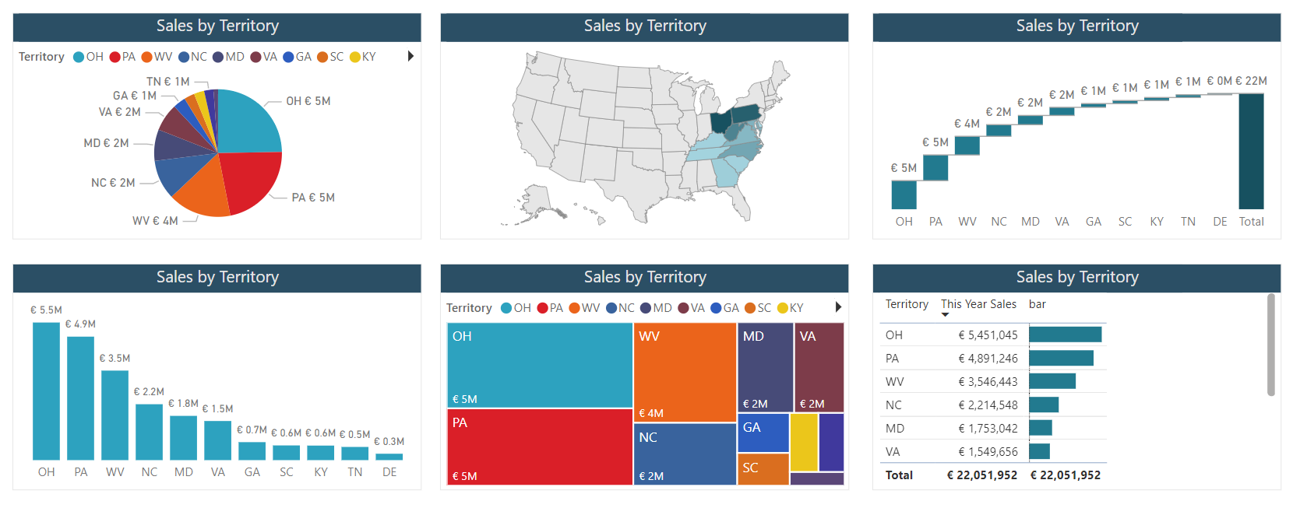
Choosing the “right” visual
Notes:
Pie chart
Shape Map
Waterfall chart
Bar chart
Treemap
Matrix with conditional formatting
v

Slide 17
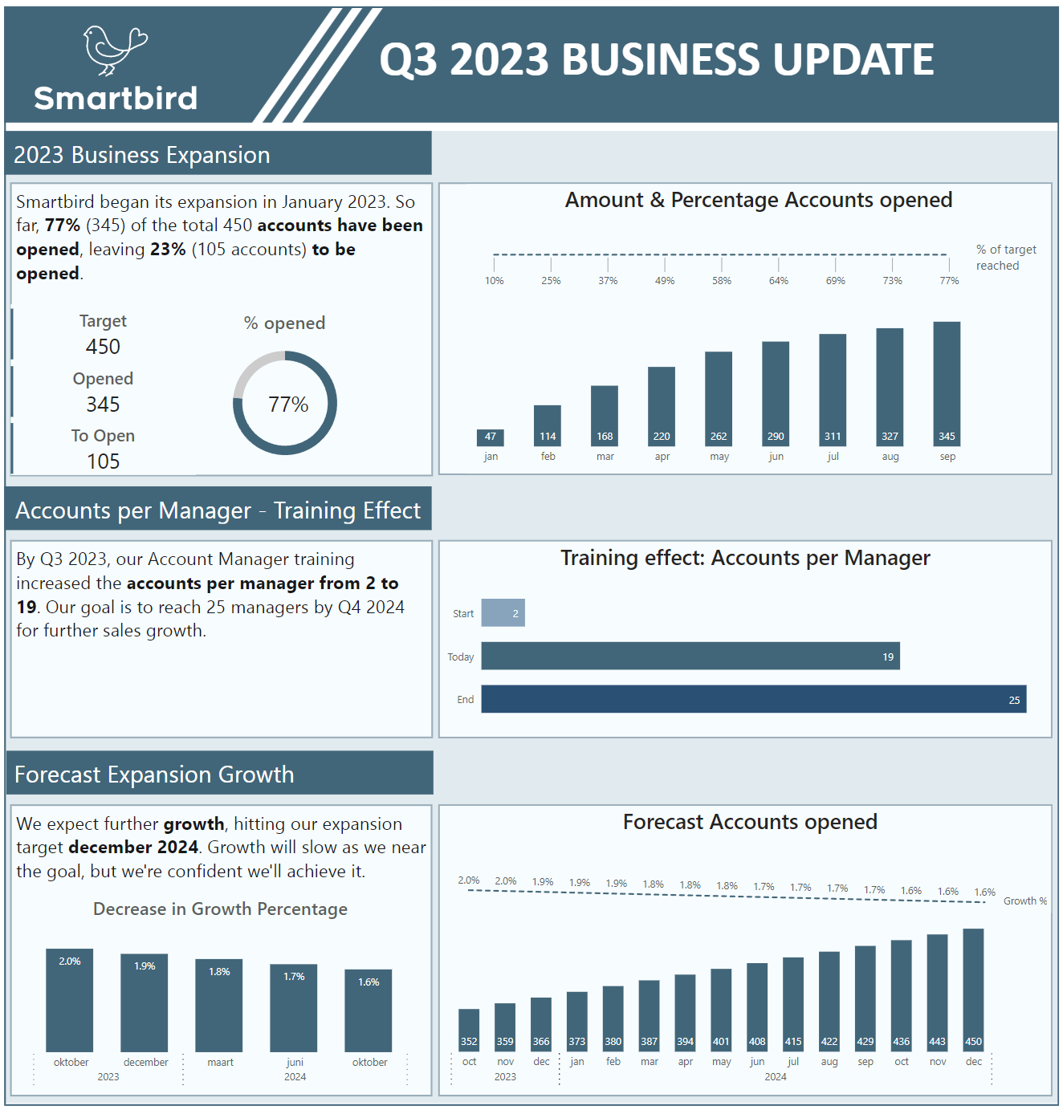
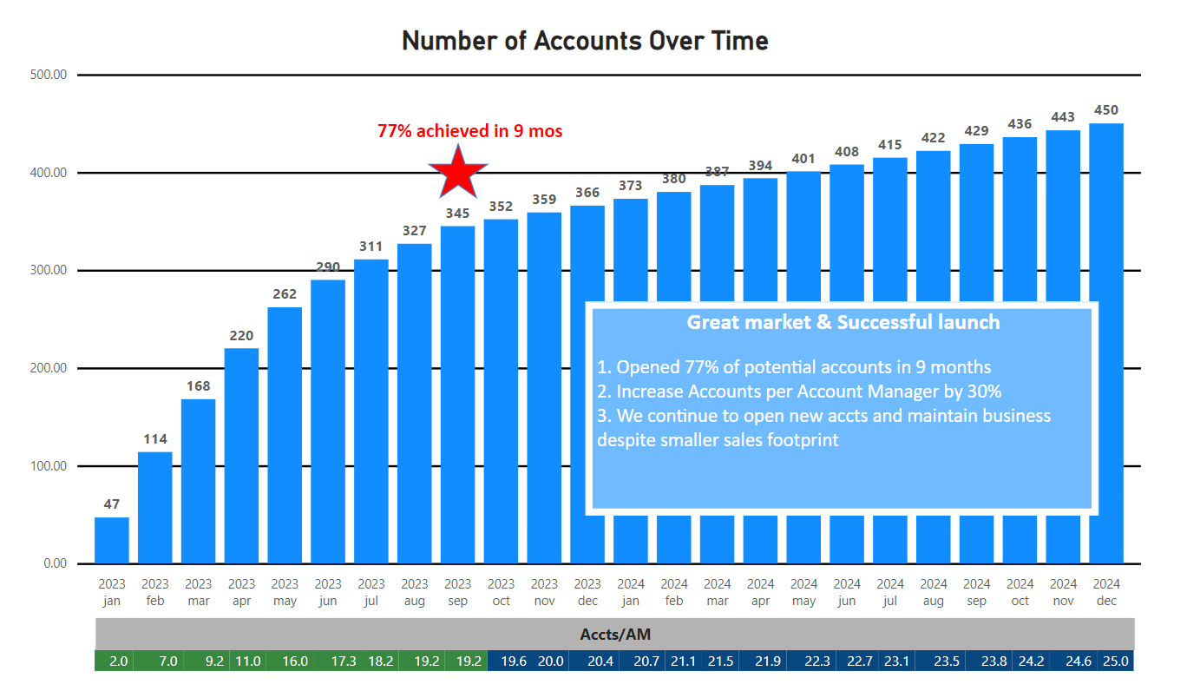
Simple, Relevant and easy to interpret
Too complex = Frustration
Don’t overestimate the amount of time a user is willing to spend to find information
Too complex = Frustration
Don’t overestimate the amount of time a user is willing to spend to find information
Notes:
Pie chart
Shape Map
Waterfall chart
Bar chart
Treemap
Matrix with conditional formatting
v

Slide 18
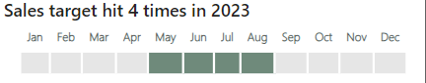
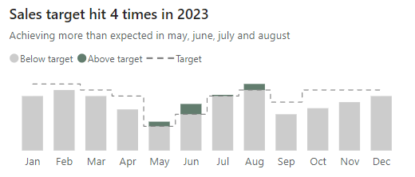
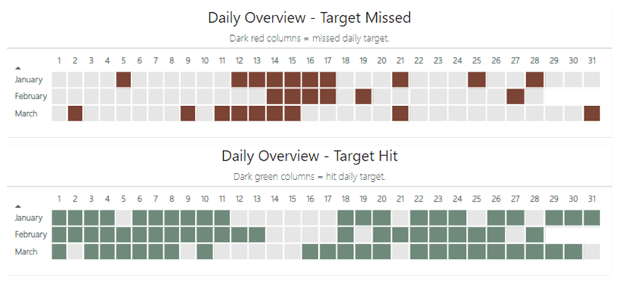
If possible - Simplify

Slide 19
Adding Context
Legend
Color coding
Meaningful titles
Notes:
Just like with a story – some context – who are those people??
Explanatory title instead of
Text as explanation – especially when communicating something fixed – daily refreshing report can be hard but not changing – why not

Slide 20
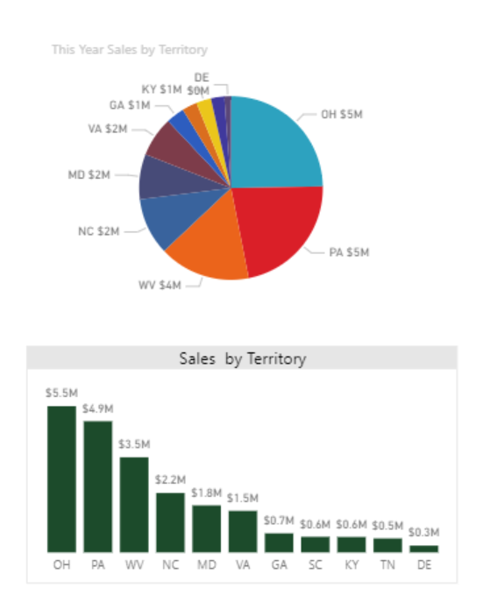
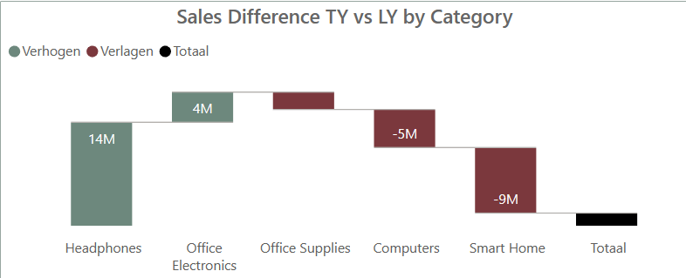
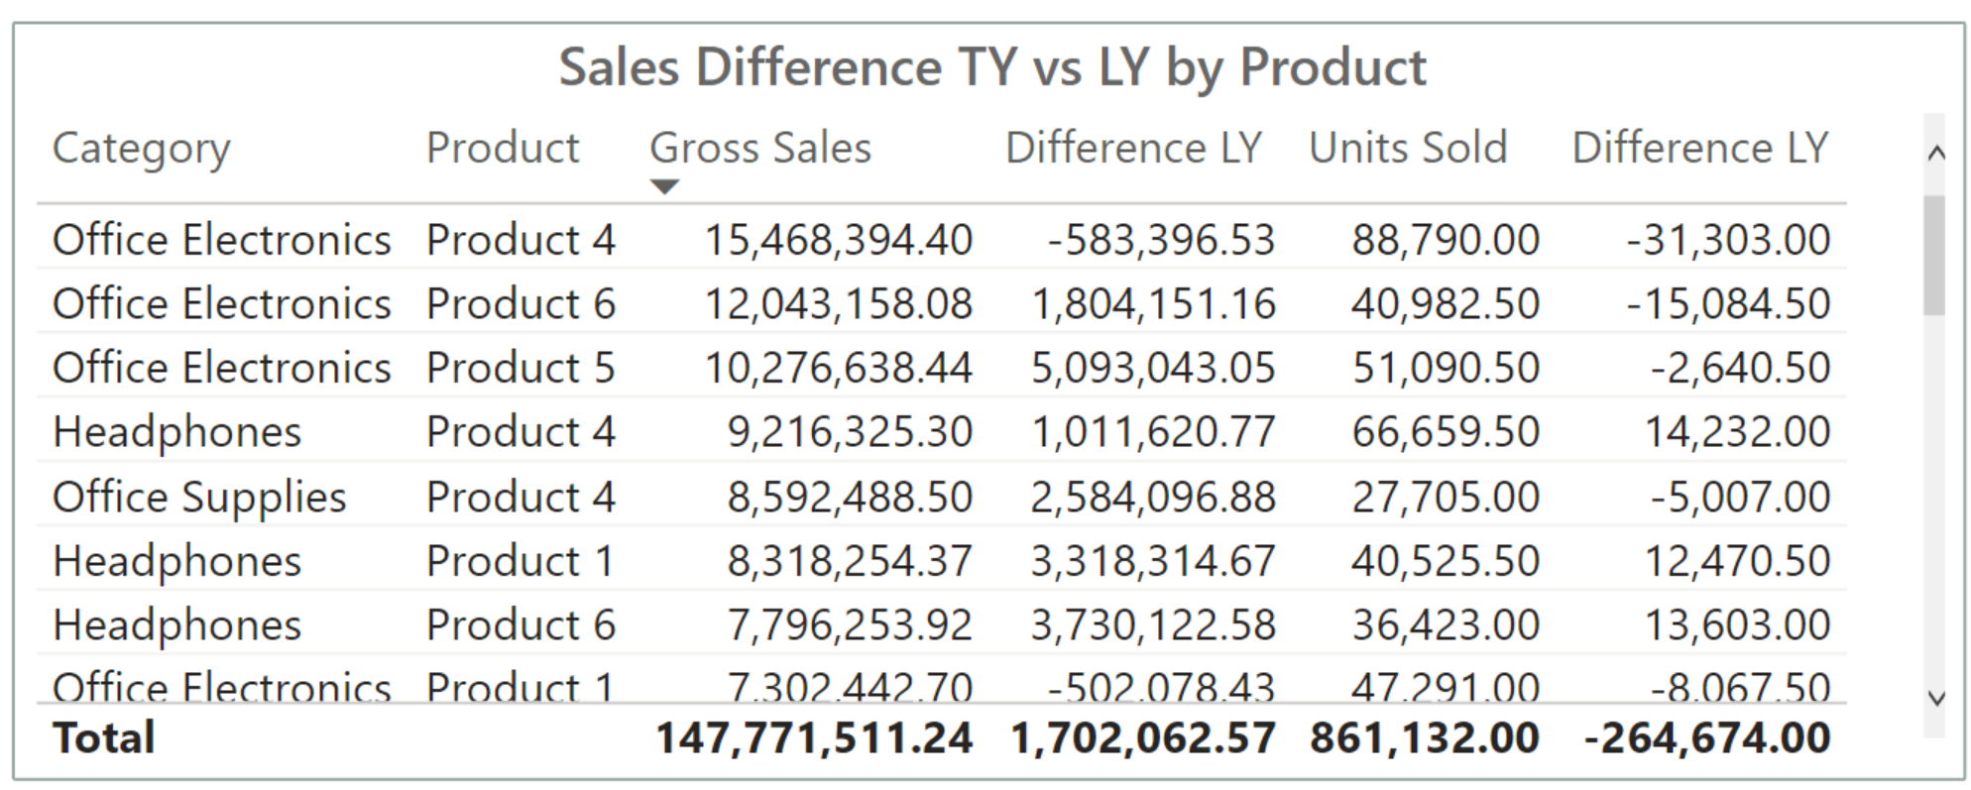
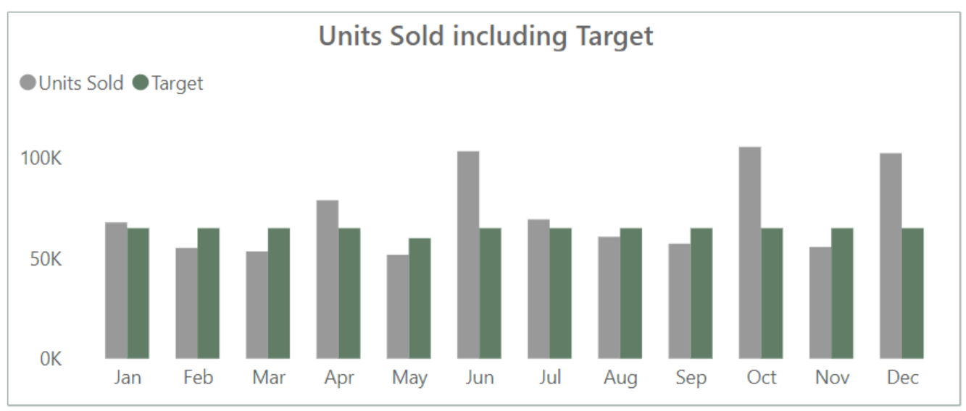
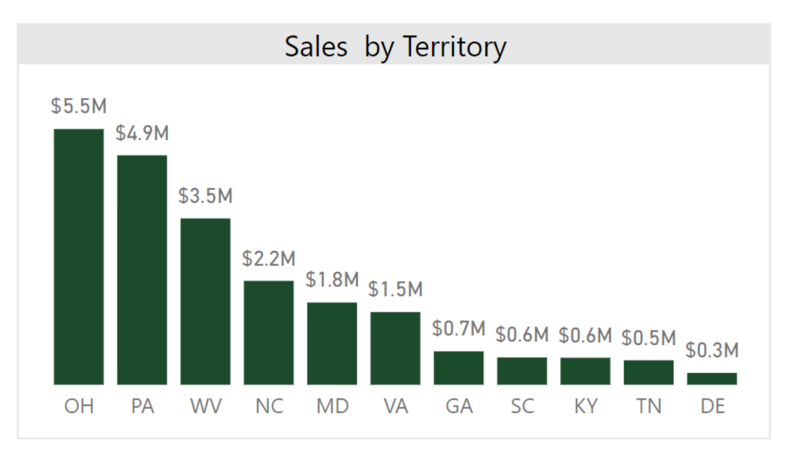
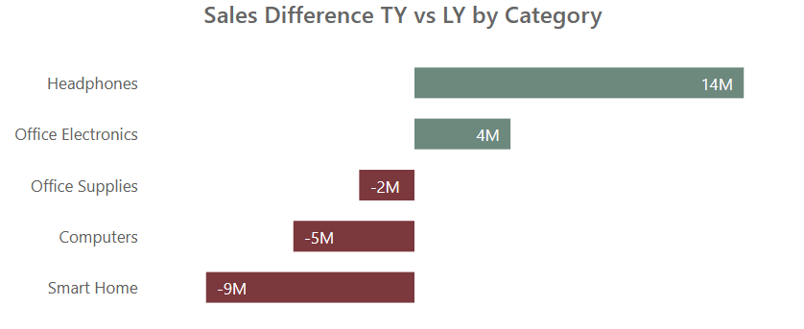
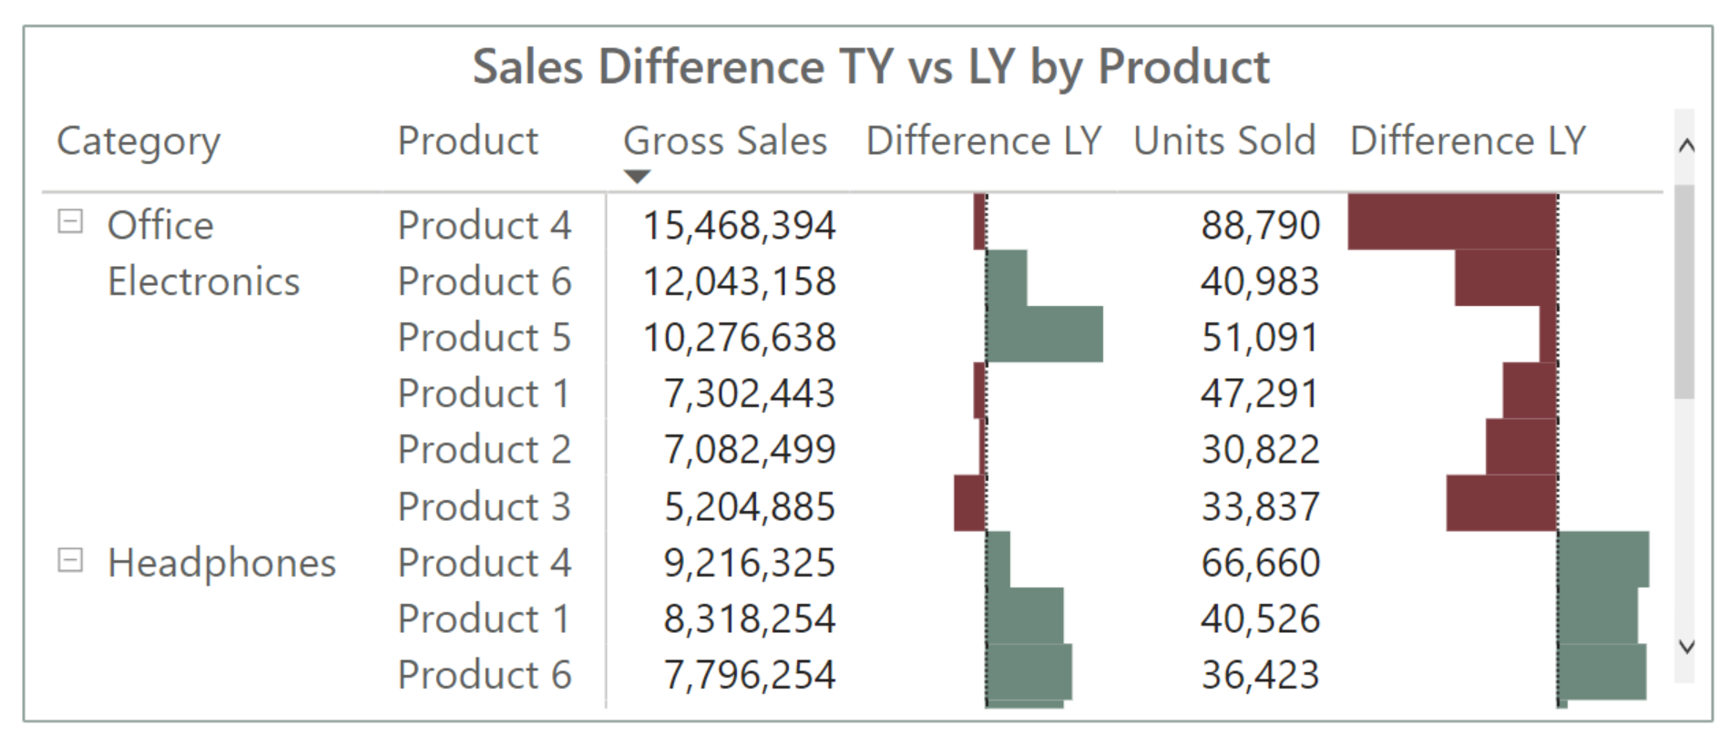
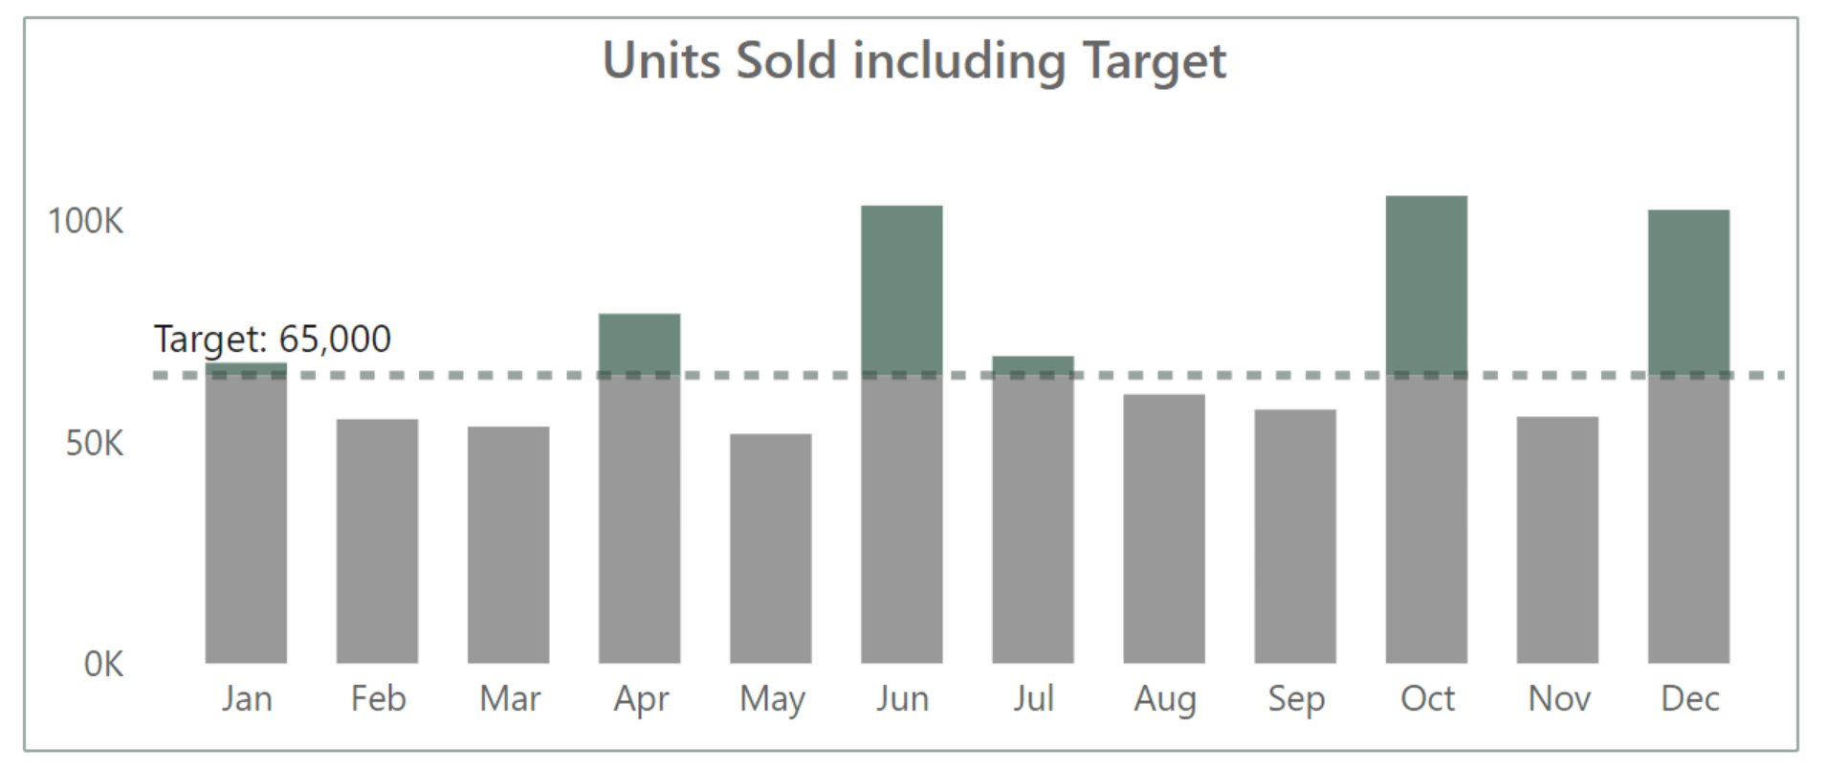
Check every visual

Slide 21
Deliver
Evaluate & Test
Notes:
50

Slide 22

IT’S PERFECT!
Notes:
Especially when first report or long waiting for report, first reactions will be positive
Finally automatization
Finally press one button and get data
But
Only after time people know what they are missing

Slide 23
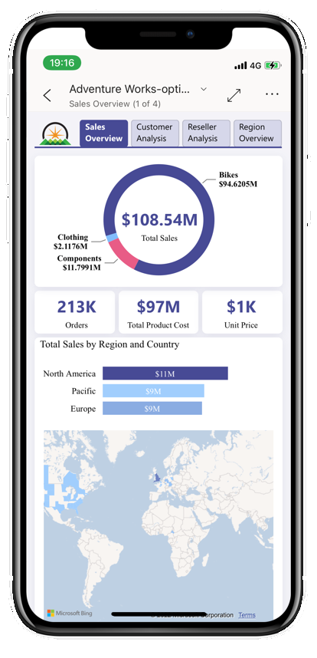
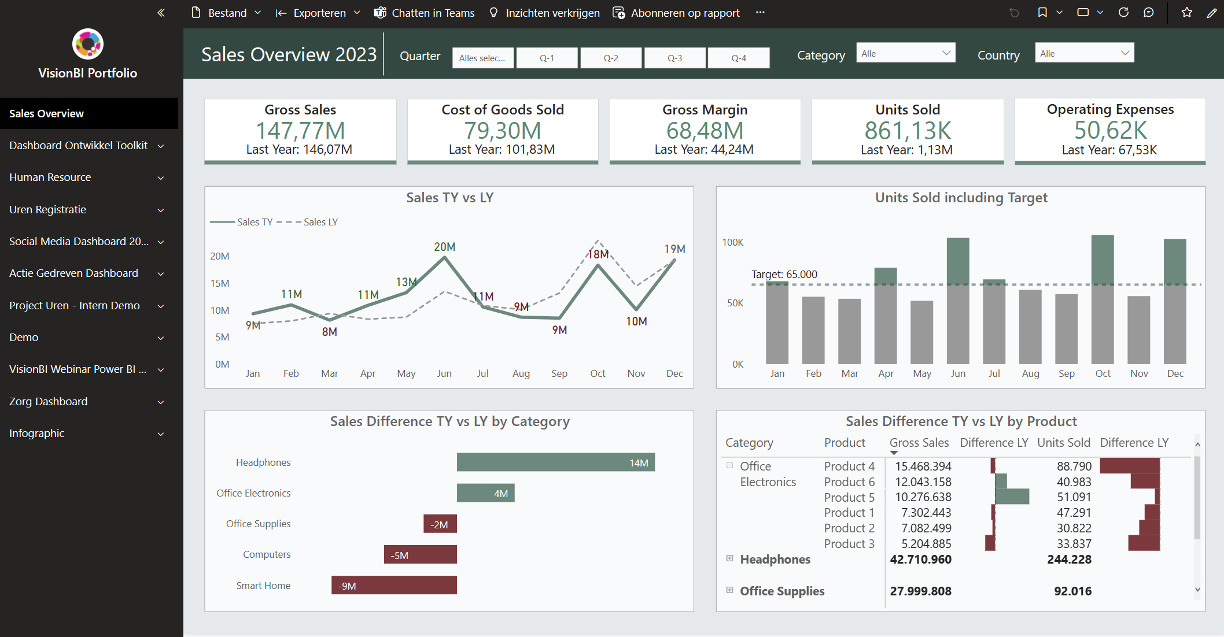
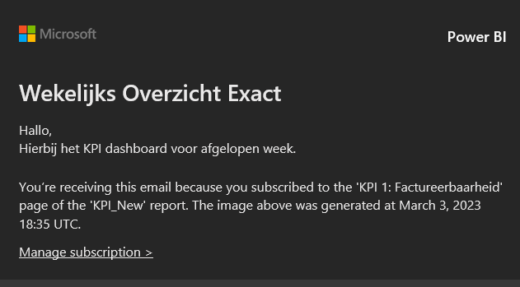
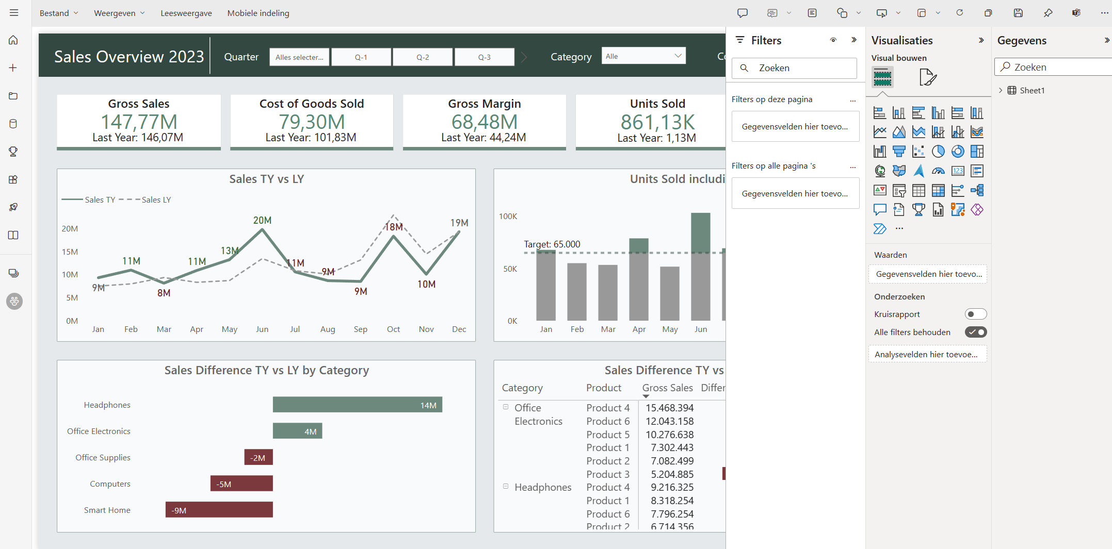
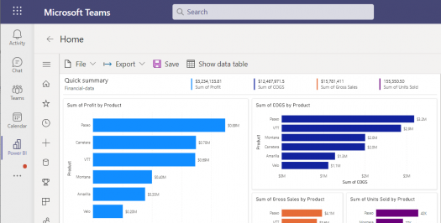
Delivery
App
Mail (PDF)
Workspace
Teams
Phone

Slide 24

Evaluate & Test
Continuous testing
Evaluate with users
Reflect & Feedback
Usage Report
Notes:
Test run
Reflect & feedback
Evaluate with users
Usage report

Slide 25
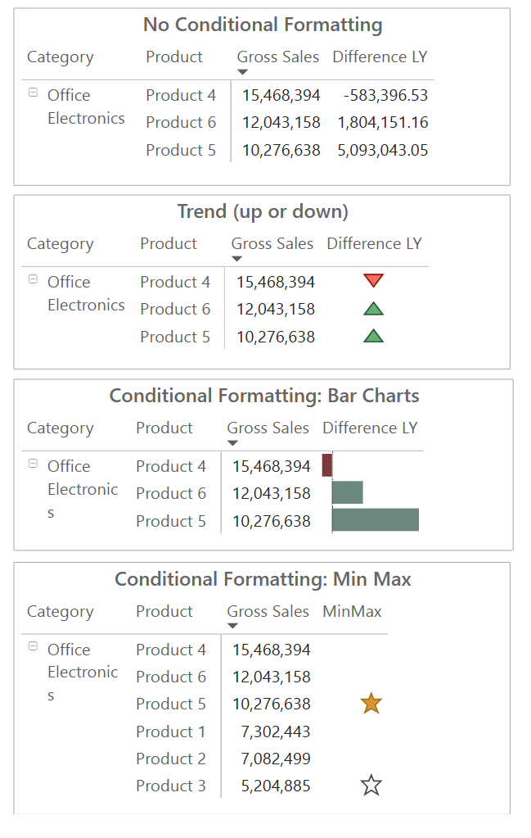
What if it doesn’t work?
Avoid adding unnecessary data, filters, or options just to complete the task.
Review the visuals.
Provide guidance during the process.
Notes:
Test run
Reflect & feedback
Evaluate with users
Usage report

Slide 26
Takeaway
Talk to your audience
1 key message
Use a Storyboard & Templates
Evaluate

Slide 27




Contact
info@porcubi.nl
https://www.linkedin.com/in/valeriejunk/
@valeriejunk.bsky.social
PorcuBI

